Slide 1


Coffee Dataset
EDA
Reinforcement Project
Sibimanyu M

Slide 2
01
Define the Objective
Understand the problem you're trying to solve or the question you're answering.
Collaborate with stakeholders to clarify goals, KPIs, or hypotheses.

Slide 3
Goal: To explore, clean, and analyze the coffee quality dataset to uncover patterns and actionable insights related to coffee quality.
Key Questions:
What factors influence cup quality?
How do origin, altitude, or processing affect taste?
How do Arabica and Robusta compare

Slide 4
02
Dataset Overview
What the data includes:
Quality metrics (e.g., Aroma, Flavor, Acidity...)
Bean metadata (Species, Processing Method, Color)
Farm metadata (Country, Region, Altitude)

Slide 5
Acidity
The bright, lively, and sometimes fruity notes that contribute to a vibrant and complex. Not the pH.
Flavor
The overall perception of taste and aroma, encompassing the combined sensations of taste, smell, and mouthfeel.
Body
It is the sensation of heaviness, thickness, or viscosity of the coffee in your mouth. It's the difference between drinking something light like water and something thick like milk.
Aftertaste
It refers to the lingering taste sensation in the mouth after swallowing a sip.
Sweetness
It refers to the pleasant, natural sugar-like quality in the flavor of the coffee.
Moisture
The amount of water in the green coffee beans.
Uniformity
The consistency in bean size, roast development, and particle size during grinding
Balance
Balanced → flavors complement each other
Unbalanced → too bitter or sour
Category Defect 1
Full black or sour bean, pod/cherry, and large or medium sticks or stones.
Cupper Points
It is the overall score given to a coffee sample based on the sensory evaluation of its attributes, including fragrance/aroma, acidity, flavor, body, aftertaste, sweetness, uniformity, and cleanliness, and taking into account any defect.
Category Defect 2
Parchment, hull/husk, broken/chipped, insect damage, partial black or sour, shell, small sticks or stones, water damage.

Slide 6
03
Data Cleaning (Preprocessing)
Handle missing values
Remove or correct duplicates
Fix data type inconsistencies
Normalize or standardize data if needed
Detect and address outliers

Slide 7
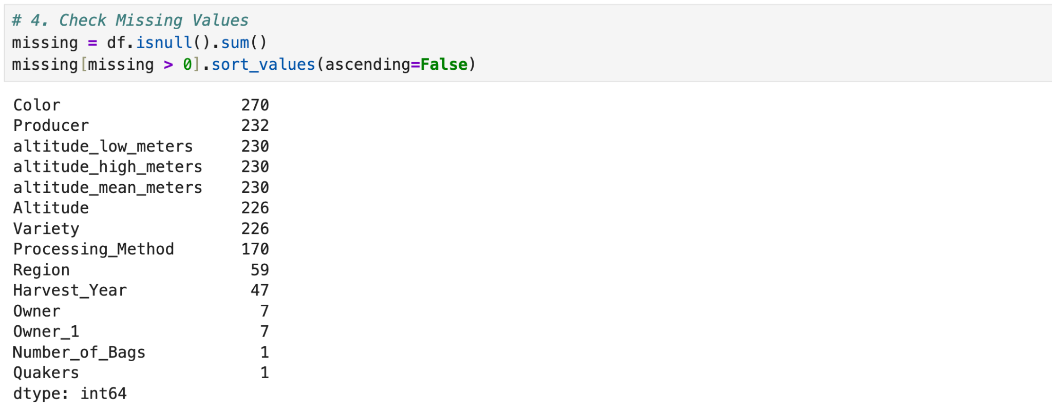
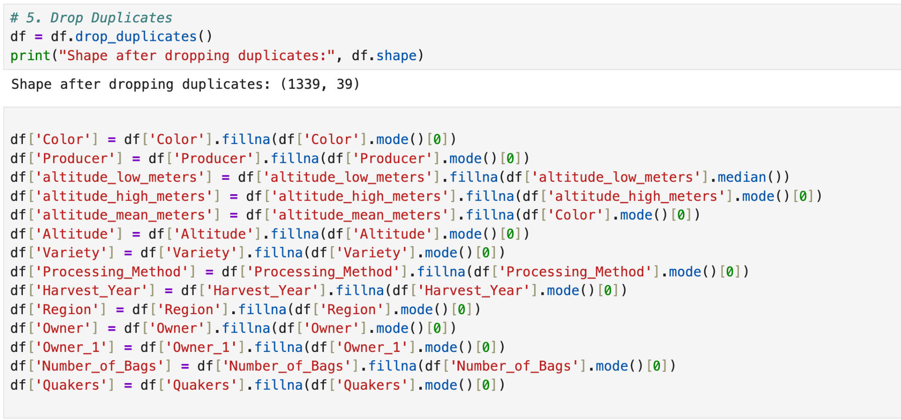
Actions Taken:
Dropped duplicates
Checked and handled missing values
Ensured consistent formatting in columns like species or processing methods

Slide 8
04
Exploratory Data Analysis (EDA)
Use descriptive statistics (mean, median, mode, standard deviation, etc.)
Visualize the data (bar plots, histograms, box plots, etc.)
Identify patterns, relationships, and potential anomalies

Slide 9
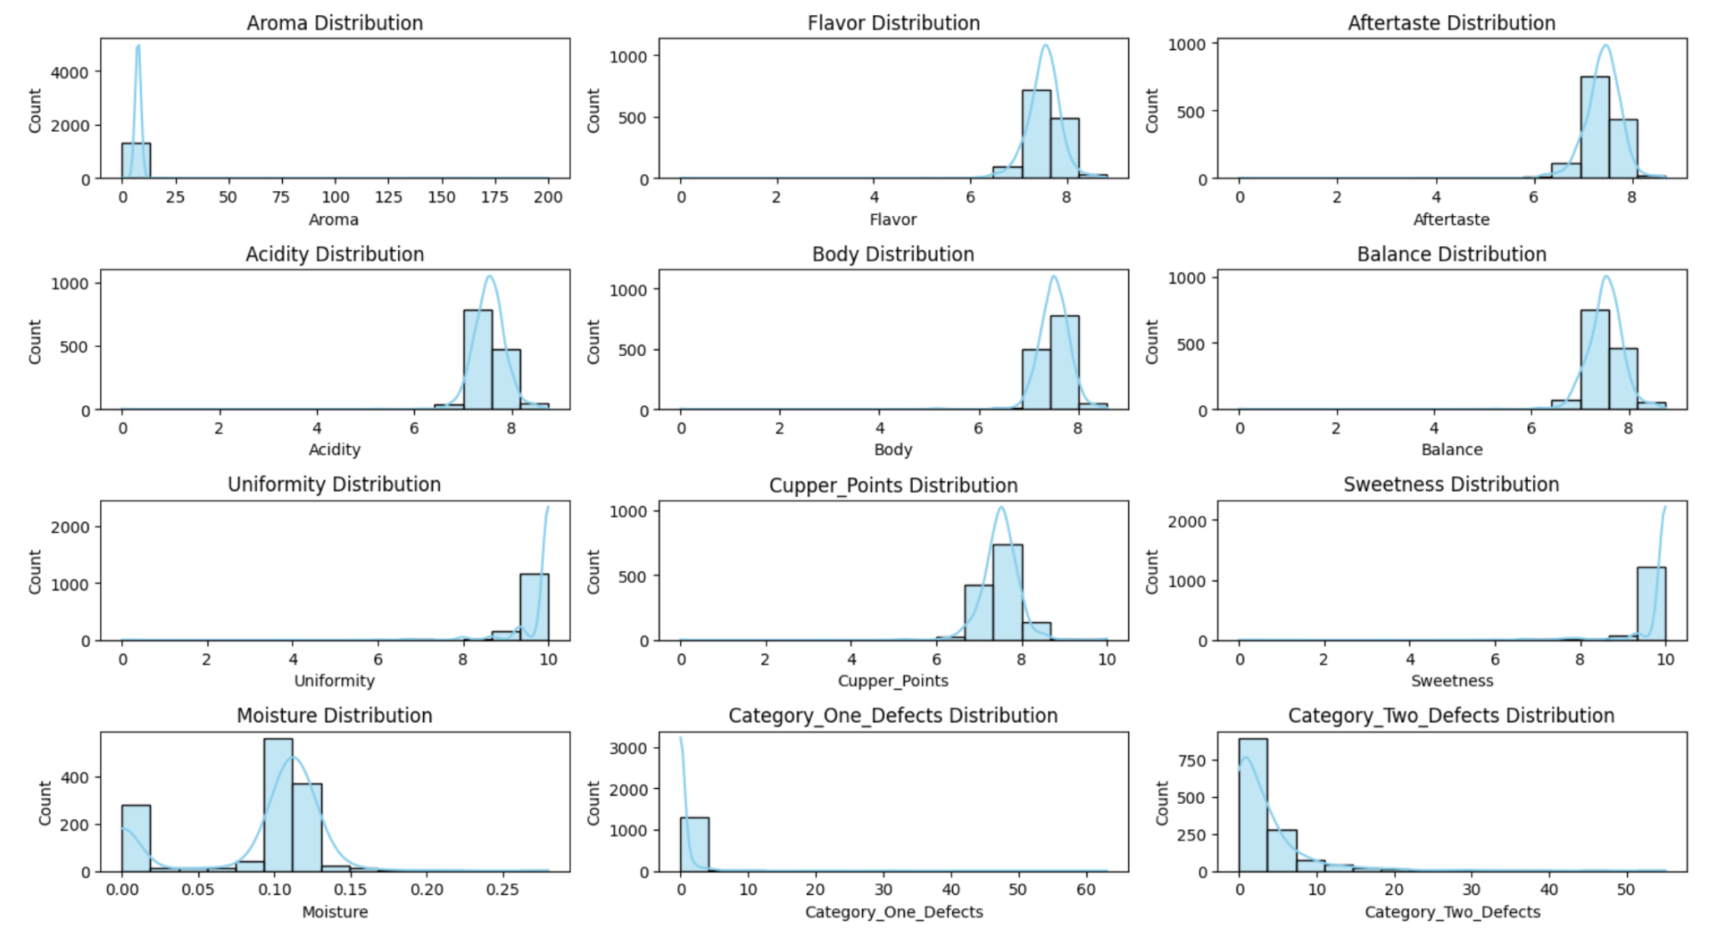

Slide 10
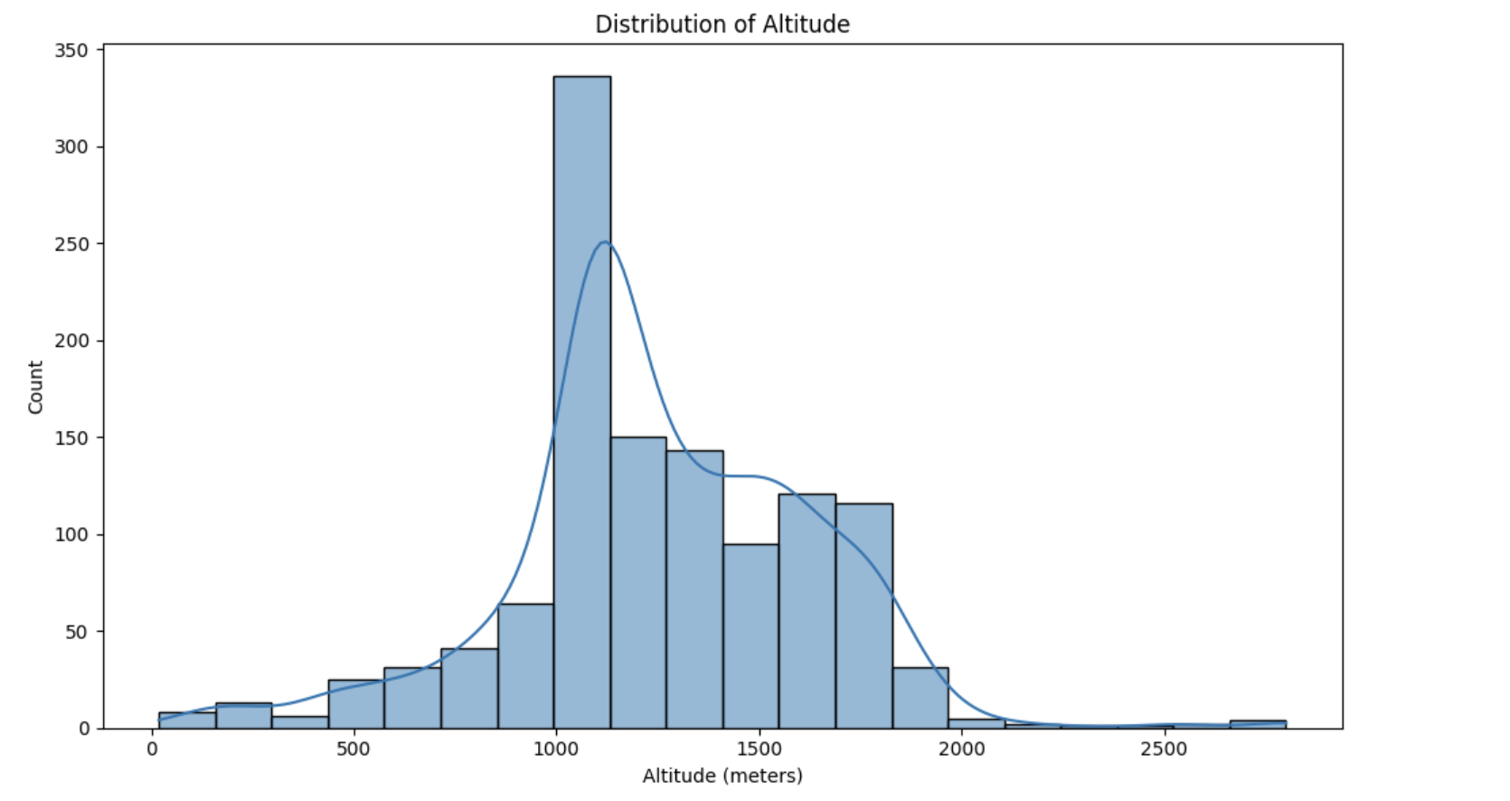

Slide 11
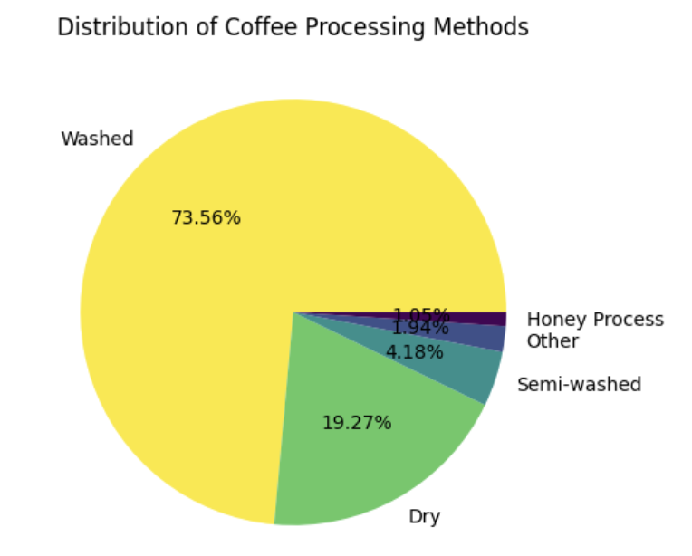
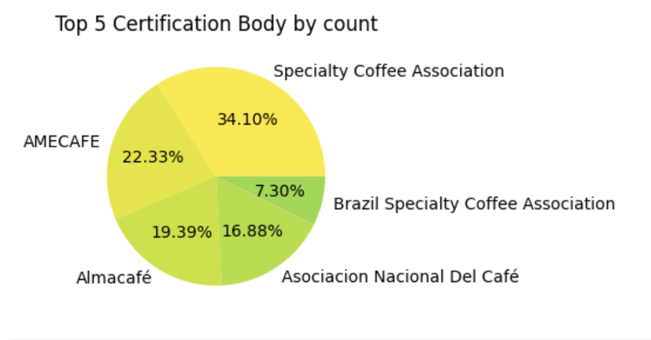
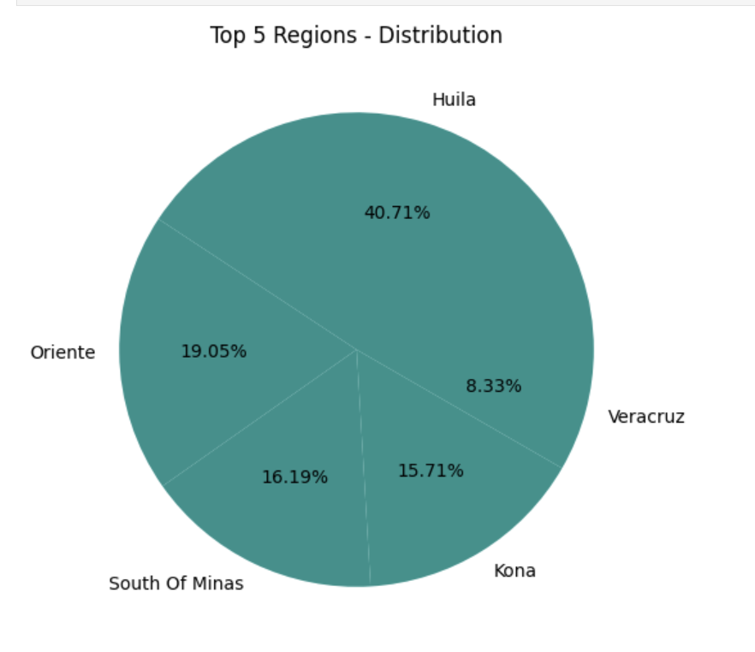
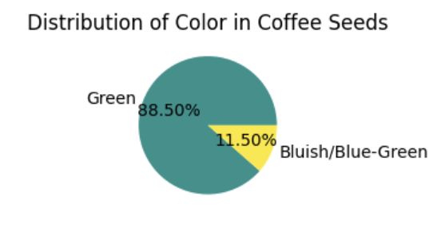

Slide 12
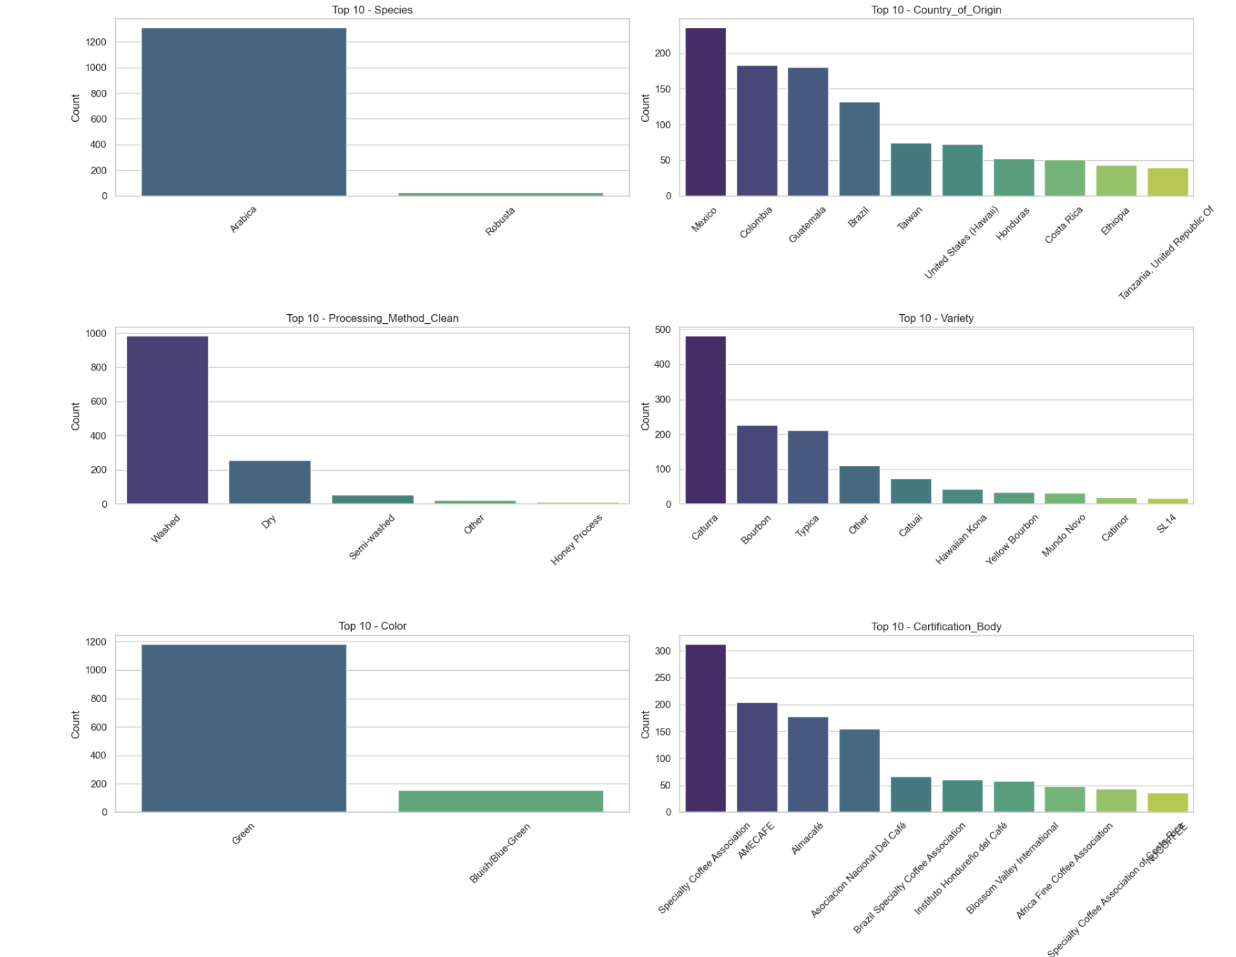
Observations
Species: Dominated by Arabica
Country_of_Origin: Mexico, Colombia, and Guatemala are top producers
Processing_Method_Clean: Washed is by far the most common
Variety: Caturra leads, followed by Bourbon and Typica
Color: Almost all are Green
Certification_Body: Specialty Coffee Association appears most frequently

Slide 13
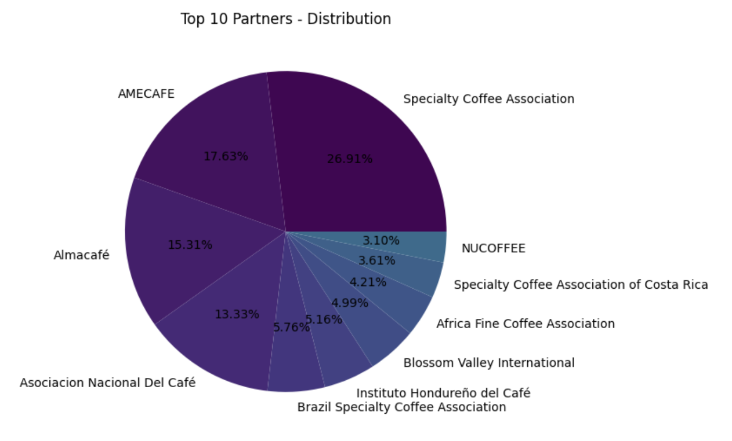
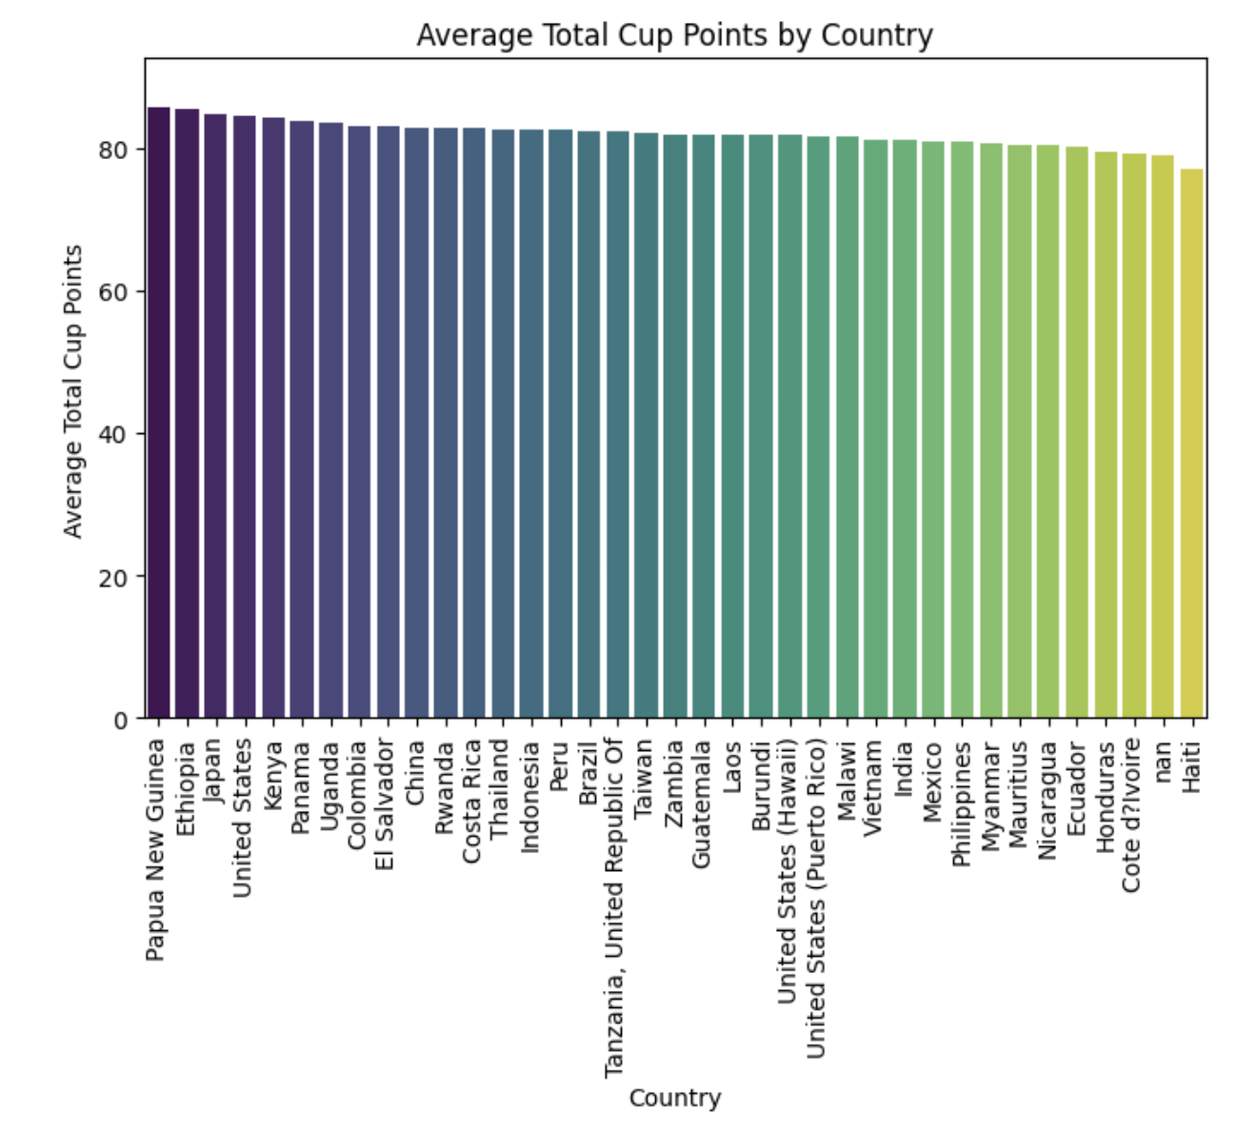

Slide 14
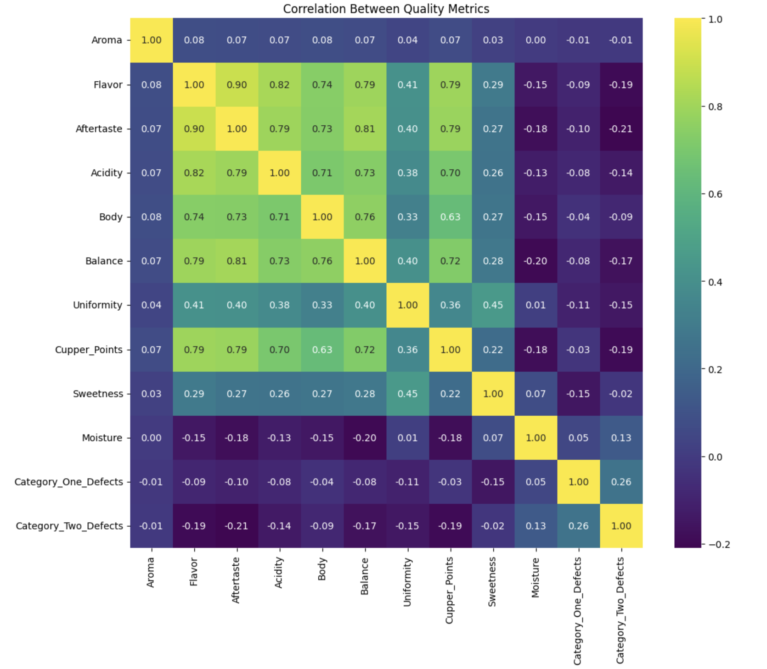
Multivariate:
We find the correlation matrix on this heatmap to identify columns that are correlated.
Quality columns such as Flavor, Aftertaste, Acidity, Body, Balance have high correlation.

Slide 15
05
Data Modeling / Statistical Analysis
Apply appropriate statistical tests or machine learning models:
T-tests, ANOVA, correlation analysis
Regression, classification, clustering, etc.
Split data into training and testing sets if building predictive models

Slide 16
Scenario 1: Is the average total cup score different between Arabica and Robusta beans?
Goal: Test if there's a significant difference in mean cup score between Arabica and Robusta.
Species (categorical: Arabica / Robusta) Total_Cup_Points (numerical)
H₀ (Null Hypothesis): Mean Total_Cup_Points is equal for Arabica and Robusta beans.
𝐻0: 𝜇 Arabica = 𝜇 Robusta
H1 (Alternative Hypothesis): Mean Total_Cup_Points is not equal for Arabica and Robusta.
𝐻1: 𝜇 Arabica ≠ 𝜇 Robusta
Hypothesis Test: Arabica vs Robusta
T-Test Statistic = 2.6450
p-value = 0.0130
Reject H0: Significant difference in Total Cup Points between Arabica and Robusta.

Slide 17
Scenario 2: Is the average total cup score different between different varieties?
Goal: Test if there's a significant difference in mean cup score between Varieties.
Variety (categorical: Caturra/Bourbon/Typica/other etc) Total_Cup_Points (numerical)
H₀ (Null Hypothesis): Mean Total_Cup_Points is equal for all varieties.
𝐻0: 𝜇 Bourbon = 𝜇 Typica = 𝜇 Caturra
H1 (Alternative Hypothesis): Mean Total_Cup_Points is not equal for different Varieties.
𝐻1: 𝜇 Bourbon ≠ 𝜇 Typica ≠ 𝜇 Caturra ≠ ...
F-statistic: 4.4771, p-value: 0.0001
Reject H0: At least one variety has a significantly different mean Total Cup Points.

Slide 18

Thank you!

